Slide 1
The Architecture Process
Understand the System’s Requirements
Understand the Non-Functional Requirements
Map the Components
Select the Technology Stack
Design the Architecture
Write Architecture Document
Support the Team

Slide 2
Understand the System’s Requirements
Understand the System’s Requirements
Understand the Non-Functional Requirements
…right after setting the goals…
Requirements = What the System Should Do
Usually Defined by the System Analyst
Map the Components
Select the Technology Stack
Design the Architecture
Write Architecture Document
Support the Team

Slide 3
Understand the Non-Functional Requirements
Understand the System’s Requirements
Understand the Non-Functional Requirements
Define Technical & Service Level Attributes
ie. # of Users, Loads, Volumes, Performance
Not Always Known to the Client or Analyst
Much More Important Than Regular Requirements
Map the Components
Select the Technology Stack
Design the Architecture
Write Architecture Document
Support the Team

Slide 4
Map the Components
Understand the System’s Requirements
Understand the Non-Functional Requirements
Represent the Tasks of the System
Two Goals:
Understand the System Functionality
Communicate Your Understanding to the Client
Non-Technical
Map the Components
Select the Technology Stack
Design the Architecture
Write Architecture Document
Support the Team

Slide 5

Select the Technology Stack
Understand the System’s Requirements
Understand the Non-Functional Requirements
Map the Components
Select the Technology Stack
Design the Architecture
Write Architecture Document
Usually for Back End, Front End, Data Store
A Lot of Factors, Choose Wisely!
Support the Team

Slide 6

Understand the System’s Requirements
Understand the Non-Functional Requirements
Map the Components
Select the Technology Stack
Design
the
Architecture
Design the Architecture
Write Architecture Document
Support the Team

Slide 7
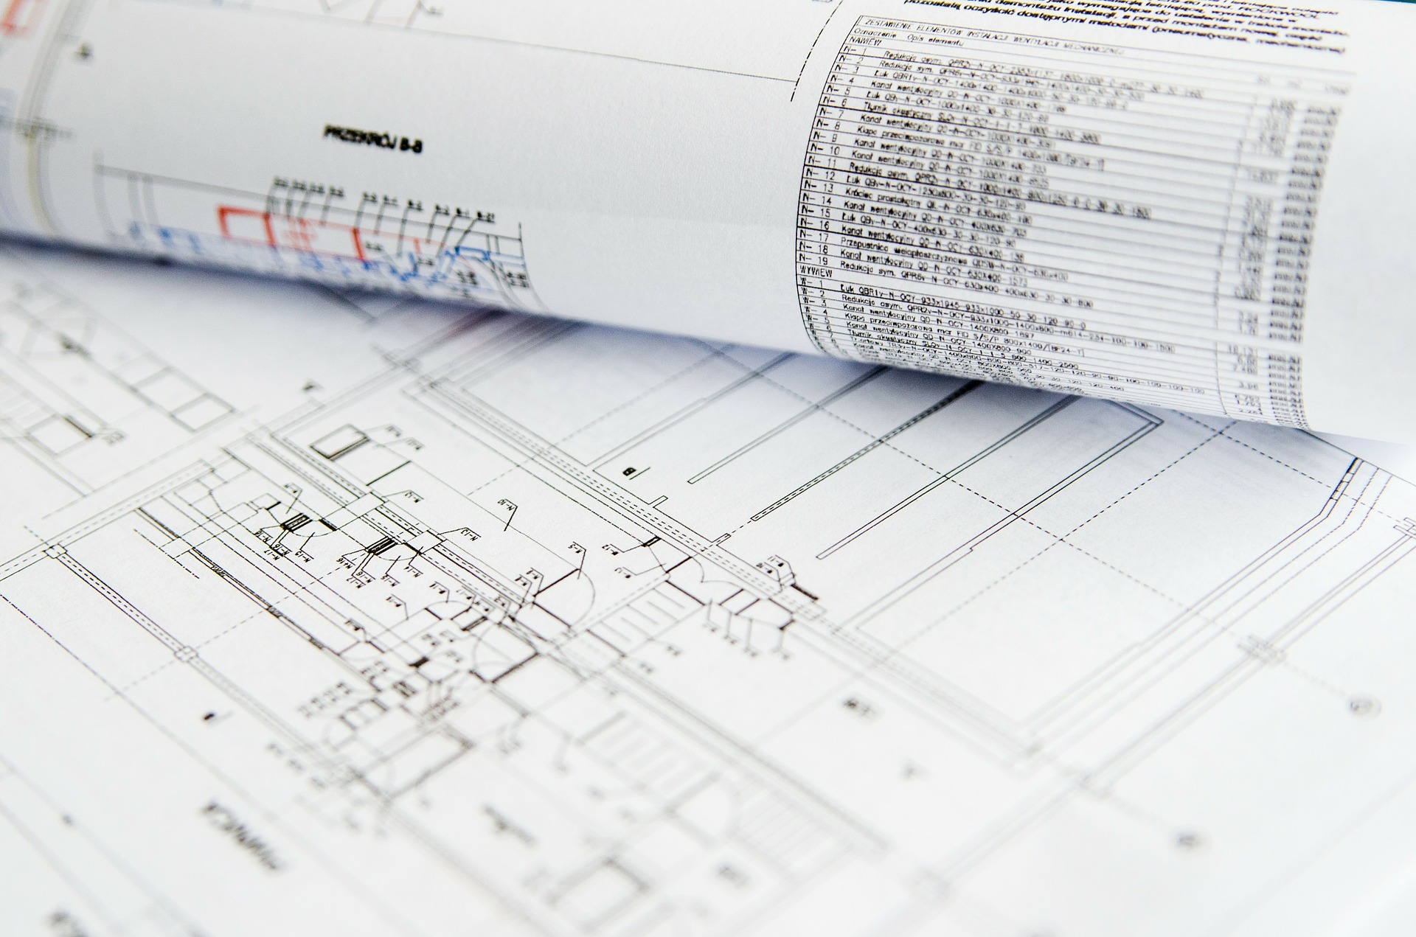
Understand the System’s Requirements
Understand the Non-Functional Requirements
Describes the Process and the Architecture
Must be Relevant for All Participants
Map the Components
Select the Technology Stack
Write
the
Architecture
Document
Design the Architecture
Write Architecture Document
Support the Team

Slide 8

Understand the System’s Requirements
Understand the Non-Functional Requirements
Map the Components
Support the Team
Select the Technology Stack
Design the Architecture
The Architecture will change a lot
Make sure it will stay relevant
Write Architecture Document
Support the Team

Slide 9

Conclusion
Understand the System’s Requirements
Understand the Non-Functional Requirements
Map the Components
Select the Technology Stack
Design the Architecture
Learn about Unknown Scenarios Early
Grow Ambassadors
Write Architecture Document
Support the Team

Slide 10
The Architecture Process
Understand the System’s Requirements
Understand the Non-Functional Requirements
Map the Components
Select the Technology Stack
Design the Architecture
Write Architecture Document
Support the Team

Slide 11
Application Introduction
Defining Requirements
Components Mapping
Technology Stack Selection
Architecture Design

Slide 12
Dunderly
Your Paper Source

Slide 13

Dunderly
Sells Paper Supplies
Printer paper, Envelopes, etc.
Needs a new HR system
Managing employees, salaries, vacations, payments

Slide 14
Dunderly
Requirements
Functional
Non-Functional
What the system should do
What the system should deal with
Web Based
Perform CRUD operations on employees
Manage Salaries:
Allow manager to ask for employee’s salary change
Allow HR manager to approve / reject request
Manage vacation days
Use external payment system

Slide 15
Dunderly
NFR - What We Know
Classic Information System
Not a lot of users
Not a lot of data
Interface to external system

Slide 16
Dunderly
NFR - What We Ask
“How many expected concurrent users?”
“How many employees?”
“What do we know about the external Payment system?”
10
250

Slide 17
Dunderly
Payment System
Legacy system, written in C++
Hosted in the company’s servers farm
Input – only files ☹
File received once a month

Slide 18
Dunderly
Data Volume
1 Employee = ~1MB in data
Each employee has ~10 scanned documents (contract, reviews etc.)
1 Scanned Document =~5MB
Total storage for 1 employee = ~51MB

Slide 19
Dunderly
Data Volume – Cont.
Company expects to grow to 500 employees in 5 years
Total storage: 51MB X 500 employees = 25.5GB
Not a lot, but:
Need to consider document storage

Slide 20
Dunderly
SLA
4. “How critical is the system?”
Not Very Critical

Slide 21
Dunderly
Requirements
Functional
Non-Functional
What the system should do
What the system should deal with
Web Based
Perform CRUD operations on employees
Manage Salaries:
Allow manager to ask for employee’s salary change
Allow HR manager to approve / reject request
Manage vacation days
Use external payment system
10 Concurrent users
Manages 500 users
Data volume forecast: 25.5GB
Relational & Unstructured
Not mission critical
File-based interface

Slide 22
Dunderly
Components
Based on requirements:
Entities: Employees, Vacation, Salary
Interface to the Payment System
Employees Service
Salary Service
Vacation Service
View Service
Performs CRUD Operations on Employees
Salary approval workflow
Employee’s Vacation Management
Returns static files to the browser (HTML, CSS, JS)
Payment System
Payment Interface
Q: Single or Per Service Data Store?
Data Store
Sends payment data to payment system
A: Data is shared between services, so a Single Data Store is better
Logging

Slide 23

Dunderly
Messaging
Users’ Browser
HTML Page
REST API / HTTP
Employees Service
Salary Service
Vacation Service
View Service
Queue
Data Store
Payment System
Payment Interface
Logging
File

Slide 24
Dunderly
Components
Users’ Browser
HTML Page
REST API / HTTP
Employees Service
Salary Service
Vacation Service
View Service
Queue
Data Store
Payment System
Payment Interface
Logging
File

Slide 25
Dunderly
Logging Service
Very Important
Other services use it

Slide 26
Dunderly
Logging - Questions
Is there an existing logging mechanism in the company?
Develop our own or use 3rd party?
No

Slide 27
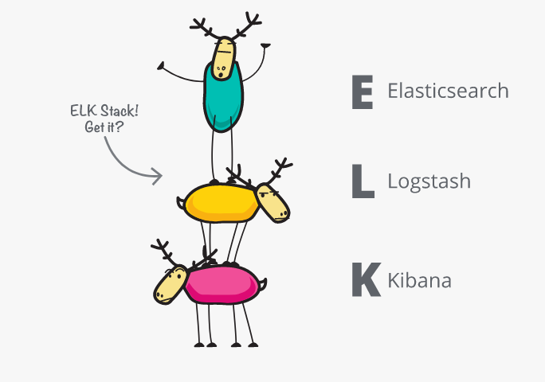
Dunderly
Logging - Alternative

Slide 28
Dunderly
Logging - Alternative
ELK:
Powerful data store (Elastic)
Import log from many sources (Logstash)
Great viewer with filter capabilities (Kibana)

Slide 29
Dunderly
Logging - Alternative
But:
Requires maintenance
Quite complicated to install and setup
Suitable mainly for large, data-intensive systems
No Go

Slide 30
Dunderly
Logging Service
Steps:
Decide on Application Type
Decide on Technology Stack
Design the Architecture

Slide 31
Dunderly
Application Type
What it does:
Read log records from queue
Validate the records
Store in data store

Slide 32
Dunderly
Application Type
What it does:
Read log records from queue
Handle the records
Save in data store

Slide 33


Application Type
Web App & Web API
Mobile App
Console
Service
Desktop App

Slide 34
Application Type
Web App & Web API
Mobile App
Console
Service
Desktop App

Slide 35
Technology Stack
For:
Component’s Code
Data Store

Slide 36

Technology Stack
Code Should:
Access Queue’s API
Validate the data
Store the data
We’re familiar with Microsoft stack, so we are expert in .NET and SQL Server

Slide 37


Technology Stack

Slide 38
Architecture
User Interface / Service Interface
Business Logic
Data Access
Data Store

Slide 39
Architecture
User Interface / Service Interface
Business Logic
Data Access
Data Store

Slide 40
Logging Service
Polling
Polls the Queue every few seconds for log records
Dependency Injection
using
Business Logic
Validates the records
Microsoft.Extensions.DependencyInjection
Data Access
Saves the records in the data store
Uses Entity Framework
Data Store

Slide 41
Dunderly
Logging Service Redundancy
X
Logging Service

Slide 42
Dunderly
Logging Service Redundancy
Logging Service
Active / Active
Avoid duplicate reads?
Is Alive
Logging Service

Slide 43
Dunderly
Logging Service Redundancy
X
Logging Service
Is Alive
Logging Service

Slide 44
Dunderly
Logging Service Redundancy
X
Logging Service
Is Alive? No!
Logging Service

Slide 45
Dunderly
Logging Service Redundancy
X
Logging Service
Is Alive? No!
Logging Service

Slide 46
Dunderly
Components
Users’ Browser
HTML Page
REST API / HTTP
Employees Service
Salary Service
Vacation Service
View Service
Queue
Data Store
Payment System
Payment Interface
Logging
File

Slide 47
Dunderly
View Service
What it does:
Get requests from the end users’ browsers
Returns static files (HTML / CSS / JS)

Slide 48
Dunderly
Application Type
Web App & Web API
Mobile App
Console
Service
Desktop App

Slide 49
Dunderly
Technology Stack
.NET Core has a great support for Web Apps
So…

Slide 50
Dunderly
Technology Stack

Slide 51
Architecture
User Interface / Service Interface
Business Logic
Data Access
Data Store

Slide 52
Dunderly
Architecture
User Interface
Business Logic
Data Access
Data Store

Slide 53
Dunderly
View Service Redundancy
Load Balancer
View Service
View Service

Slide 54
Dunderly
Components
Users’ Browser
HTML Page
REST API / HTTP
Employees Service
Salary Service
Vacation Service
View Service
Queue
Data Store
Payment System
Payment Interface
Logging
File

Slide 55
Dunderly
Employees Service
What it does:
Allows end users to query employees’ data
Allows performing actions on data (CUD)
What it doesn’t:
- Displays the data

Slide 56
Dunderly
Application Type
Web App & Web API
Mobile App
Console
Service
Desktop App

Slide 57
Dunderly
Technology Stack – Dev Platform

Slide 58
Dunderly
Technology Stack – Database
Employee Data (Relational)
Documents
?

Slide 59
Dunderly
Technology Stack – Database
Document (BLOB) Storage Alternatives
Relational Database
File System
Object Store
Cloud Storage

Slide 60
Dunderly
Document (BLOB) Storage Alternatives
Alternative | Description | Examples | Pros | Cons
Relational Database | Store the document in a specialized column type designed for BLOBs | SQL Server’s FILESTREAM, Oracle’s BLOB type | Part of the app transaction Part of the DB’s backup / DR | Clunky syntax, Limited size

Slide 61
Dunderly
Document (BLOB) Storage Alternatives
Alternative | Description | Examples | Pros | Cons
Relational Database | Store the document in a specialized column type designed for BLOBs | SQL Server’s FILESTREAM, Oracle’s BLOB type | Part of the app transaction Part of the DB’s backup / DR | Clunky syntax, Limited size
File System | Store the document in a file, and hold a pointer to it in the DB | File System (duh…) | Unlimited size Easy to execute | Not part of transaction, Unmanageable

Slide 62
Dunderly
Document (BLOB) Storage Alternatives
Alternative | Description | Examples | Pros | Cons
Relational Database | Store the document in a specialized column type designed for BLOBs | SQL Server’s FILESTREAM, Oracle’s BLOB type | Part of the app transaction Part of the DB’s backup / DR | Clunky syntax, Limited size
File System | Store the document in a file, and hold a pointer to it in the DB | File System (duh…) | Unlimited size Easy to execute | Not part of transaction, Unmanageable
Object Store | Use special type of store mechanism that specializes in BLOBs | CEPH | Great scale Unlimited size | Complex setup Dedicated knowledge New product in the mix

Slide 63
Dunderly
Document (BLOB) Storage Alternatives
Alternative | Description | Examples | Pros | Cons
Relational Database | Store the document in a specialized column type designed for BLOBs | SQL Server’s FILESTREAM, Oracle’s BLOB type | Part of the app transaction Part of the DB’s backup / DR | Clunky syntax, Limited size
File System | Store the document in a file, and hold a pointer to it in the DB | File System (duh…) | Unlimited size Easy to execute | Not part of transaction, Unmanageable
Object Store | Use special type of store mechanism that specializes in BLOBs | CEPH | Great scale Unlimited size | Complex setup Dedicated knowledge New product in the mix
Cloud Storage | Store the documents in one of the public cloud storage mechanisms | Azure’s Storage Account AWS’s S3 | Great scale Easy to execute | Requires internet connection Cost

Slide 64
Dunderly
Technology Stack – Database
Employee Data (Relational)
Documents
?

Slide 65
Dunderly
Technology Stack – Database
Employee Data (Relational)
Documents
Documents are small (~1MB)
Already exists
Part of the app

Slide 66
Dunderly
Architecture
Service Interface
Business Logic
Data Access
Data Store

Slide 67
Dunderly
API
Get full employee details by ID
List of employees by parameters
Add employee
Update employee details
Remove employee
Not physical delete!

Slide 68
Dunderly
API – Cont.
Add document
Remove document
Get document
Retrieve documents by parameters
Q: Do we need a separate Document Handler service?
A: Since only the Employee entity requires docs, then no.

Slide 69
Dunderly
API
Functionality | Path | Return Codes
Get employee details by ID | GET /api/v1/employee/{id} | 200 OK 404 Not Found
List employees by parameters | GET /api/v1/employees?name=…&birthdate=… | 200 OK 400 Bad Request
Add employee | POST /api/v1/employee | 201 Created 400 Bad Request
Update employee details | PUT /api/v1/employee/{id} | 200 OK 400 Bad Request 404 Not Found
Remove employee | DELETE /api/v1/employee/{id} | 200 OK 404 Not Found

Slide 70
Dunderly
API
Functionality | Path | Return Codes
Add document | POST /api/v1/employee/{id}/document | 201 Created 404 Not Found
Remove document | DELETE /api/v1/employees/{id}/document/{docid} | 200 OK 404 Not Found
Get document | GET /api/v1/employees/{id}/document/{docid} | 200 OK 404 Not Found
Retrieve documents for employee | GET /api/v1/employees/{id}/documents | 200 OK 404 Not Found

Slide 71
Dunderly
Employee Service Redundancy
Load Balancer
Employee Service
Employee Service

Slide 72
Dunderly
Components
Users’ Browser
HTML Page
REST API / HTTP
Employees Service
Salary Service
Vacation Service
View Service
Queue
Data Store
Payment System
Payment Interface
Logging
File

Slide 73
Dunderly
Salary Service
What it does:
Allows managers to ask for an employee’s salary change
Allows HR representative to approve / reject the request

Slide 74
Dunderly
Application Type
Web App & Web API
Mobile App
Console
Service
Desktop App

Slide 75
Dunderly
Technology Stack

Slide 76
Dunderly
Architecture
Service Interface
Business Logic
Data Access
Data Store

Slide 77
Dunderly
API
Add salary request
Remove salary request
Get salary requests
Approve salary request
Reject salary request

Slide 78
Dunderly
API
Functionality | Path | Return Codes
Add salary request | POST /api/v1/salaryRequest/ | 200 OK 400 Bad Request
Remove salary request | DELETE /api/v1/salaryRequest/{id} | 200 OK 404 Not Found
Get salary requests | GET /api/v1/salaryRequests | 200 OK
Approve salary request | POST /api/v1/salaryRequest/{id}/approval | 200 OK 404 Not Found
Reject salary request | POST /api/v1/salaryRequest/{id}/rejection | 200 OK 404 Not Found

Slide 79
Dunderly
Salary Service Redundancy
Load Balancer
Salary Service
Salary Service

Slide 80
Dunderly
Components
Users’ Browser
HTML Page
REST API / HTTP
Employees Service
Salary Service
Vacation Service
View Service
Queue
Data Store
Payment System
Payment Interface
Logging
File

Slide 81
Dunderly
Vacation Service
What it does:
Allows employees to manage their vacation days
Allows HR to set available vacation days for employees

Slide 82
Dunderly
Application Type
Web App & Web API
Mobile App
Console
Service
Desktop App

Slide 83
Dunderly
Technology Stack

Slide 84
Dunderly
Architecture
Service Interface
Business Logic
Data Access
Data Store

Slide 85
Dunderly
API
Set available vacation days (by HR)
Get available vacation days
Reduce vacation days (by employees)

Slide 86
Dunderly
API
Functionality | Path | Return Codes
Set available vacation days | PUT /api/v1/vacation/{empid} | 200 OK 404 Not Found
Get available vacation days | GET /api/v1/vacation/{empid} | 200 OK 404 Not Found
Reduce vacation days | POST /api/v1/vacation/{empid}/reduction | 200 OK

Slide 87
Dunderly
Vacation Service Redundancy
Load Balancer
Vacation Service
Vacation Service

Slide 88
Dunderly
Components
Users’ Browser
HTML Page
REST API / HTTP
Employees Service
Salary Service
Vacation Service
View Service
Queue
Data Store
Payment System
Payment Interface
Logging
File

Slide 89
Dunderly
Payment Interface
What it does:
Queries the database once a month for salary data
Passes payment data to the external payment system

Slide 90
Dunderly
Application Type
Web App & Web API
Mobile App
Console
Service
Desktop App

Slide 91
Dunderly
Technology Stack

Slide 92
Dunderly
Architecture
Timer
Business Logic
Data Access
Data Store

Slide 93
Dunderly
Payment Interface Redundancy
Payment Interface
Is Alive
Payment Interface

Slide 94
Dunderly
Messaging
Users’ Browser
HTML Page
REST API / HTTP
Employees Service
Salary Service
Vacation Service
View Service
Queue
Data Store
Payment System
Payment Interface
Logging
File

Slide 95


Dunderly
Technology Stack – Queue
Queue Alternatives:
Self Developed
RabbitMQ
Kafka

Slide 96
Dunderly
Alternative | Description | Pros
Rabbit MQ | General purpose message-broker engine | Easy to setup Easy to use

Slide 97
Dunderly
Alternative | Description | Pros
Rabbit MQ | General purpose message-broker engine | Easy to setup Easy to use
Apache Kafka | Stream processing platform | Perfect for data intensive scenarios

Slide 98
Dunderly
Technology Stack – Queue
Queue Alternatives:
Self Developed
RabbitMQ
No data stream involved
Easy to use
Kafka

Slide 99
Dunderly
Logic Diagram
Users’ Browser
HTML Page
REST API / HTTP
Employees Service
Salary Service
Vacation Service
View Service
Queue
Data Store
Payment System
Payment Interface
Logging
File

Slide 100
Dunderly
Technical Diagram
Employees Service
Salary Service
Vacation Service
View Service
.NET Core
.NET Core
.NET Core
.NET Core
Queue
Data Store
RabbitMQ
Payment System
Payment Interface
Logging
File
.NET Core
.NET Core
SQL Server (data + BLOBs)

Slide 101
Dunderly
Physical Diagram
LB
LB
LB
LB
Employees Service
Salary Service
Vacation Service
View Service
Employees Service
Salary Service
Vacation Service
View Service
Queue
Data Store
Payment System
Payment Interface
Logging
Payment Interface
Logging
File

Slide 102
Muscar.auto
The Real Autonomous Car

Slide 103

Muscar.auto
Manufactures autonomous systems for vehicles
Has >10,000 vehicles on the roads right now
Expects more than 200,000 vehicles by end of year
Needs to reliably receive telemetry from cars and display data about them

Slide 104
Muscar.auto
Requirements
Functional
Non-Functional
What the system should do
What the system should deal with
Web Based
Receive telemetry from cars (location, speed, breakdowns, etc)
Store telemetry in a persistent store
Display dashboards summarizing the data
Perform analysis on the data

Slide 105
Muscar.auto
NFR - What We Know
Data intensive system
Not a lot of users
A lot of data
Performance is important

Slide 106
Muscar.auto
NFR - What We Ask
“How many expected concurrent users?”
“How many telemetry messages received per second?”
“What is the average size of message?”
“Is the message schema-less?”
10
7,000
1KB
Yes

Slide 107
Muscar.auto
NFR - What We Ask
“Can we tolerate some message loss?”
“What is the desired SLA?”
Sort of…
Highest Possible

Slide 108
Muscar.auto
Data Volume
1 Message = 1KB
7,000 messages / sec = 7MB / sec
=> ~25GB / hr
=> ~605GB / day
=> ~221TB / year
That’s a lot!

Slide 109
Muscar.auto
Retention Period
Defines for how long records are kept in the database
What happens to them after the retention period?
- Deleted
- Moved to archive data store

Slide 110

Muscar.auto
Retention Period
Motivation:
Keep database from exploding
Improve query performance

Slide 111
Muscar.auto
Retention Period
Muscar needs two types of data:
Operational, near-real-time (location, speed, etc.)
Aggregated and ready for analysis (BI – Business Intelligence)

Slide 112
Muscar.auto
Retention Period
Data Type | Used for… | Retention Period
Operational | Monitor real time data from cars. Performance is critical
Aggregated | Reports, BI. Not real time, can be slower.

Slide 113
Muscar.auto
Retention Period
Data Type | Used for… | Retention Period
Operational | Monitor real time data from cars. Performance is critical | 1 week
Aggregated | Reports, BI. Not real time, can be slower. | Forever

Slide 114
Muscar.auto
Data Volume
1 Message = 1KB
7,000 messages / sec = 7MB / sec
=> ~25GB / hr
=> ~605GB / day
=> ~221TB / year

Slide 115
Muscar.auto
Data Volume
1 Message = 1KB
7,000 messages / sec = 7MB / sec
=> ~25GB / hr
=> ~605GB / day
=> ~4TB / week

Slide 116
Muscar.auto
Requirements
Functional
Non-Functional
What the system should do
What the system should deal with
Web Based
Receive telemetry from cars (location, speed, breakdowns, etc)
Store telemetry in a persistent store
Display dashboards summarizing the data
Perform analysis on the data
10 Concurrent users
7,000 msgs/sec
Max data in the operational DB: 4TB
Mission critical
Performance is critical

Slide 117
Muscar.auto
Components
Based on requirements:
Receive telemetry
Validate telemetry
Store telemetry
Query & analyze telemetry
Cars
Telemetry gateway
Receives telemetry from cars
Telemetry pipeline
Queues the telemetry messages for processing
Queries the operational DB and displays real time data
Telemetry processor
Validates the messages and stores them
Telemetry Viewer
Operational DB
Archive DB
Data Warehouse
Reports and analysis
BI Application

Slide 118
Muscar.auto
Messaging
Based on requirements:
Receive telemetry
Validate telemetry
Store telemetry
Query & analyze telemetry
Cars
TCP
Telemetry gateway
Receives telemetry from cars
Telemetry pipeline
Queues the telemetry messages for processing
Queries the operational DB and displays real time data
Telemetry processor
Validates the messages and stores them
Telemetry Viewer
Operational DB
Archive DB
Data Warehouse
Reports and analysis
BI Application
ETL
ETL

Slide 119
Muscar.auto
Components
Cars
Telemetry gateway
Receives telemetry from cars
Telemetry pipeline
Queues the telemetry messages for processing
Queries the operational DB and displays real time data
Telemetry processor
Validates the messages and stores them
Telemetry Viewer
Operational DB
Archive DB
Data Warehouse
Reports and analysis
BI Application

Slide 120
Muscar.auto
Telemetry Gateway
What it does:
Receives telemetry data from cars using TCP
Pushes the telemetry data to the pipeline

Slide 121
Muscar.auto
Application Type
Web App & Web API
Mobile App
Console
Service
Desktop App

Slide 122
Muscar.auto
Technology Stack
Considerations:
Load (7,000 msgs/sec)
Performance
Team’s current knowledge
Environment (OS, etc)

Slide 123

Muscar.auto
Technology Stack
Our developers are familiar with Python, and are experts in JavaScript.
In addition, we use only Linux servers.
Python can’t be used for the gateway
Too slow
We look for a language with great performance, runs on linux, and leverages current skills (Python & JavaScript)

Slide 124


Muscar.auto
Technology Stack
Great performance
Runs on Linux
Leverages JS skills

Slide 125
Muscar.auto
Architecture
Traditional:
User Interface / Service Interface
Business Logic
Data Access
Data Store

Slide 126
Muscar.auto
Architecture
In our case:
Service Interface
Pipeline

Slide 127
Muscar.auto
Telemetry Gateway Redundancy
Load Balancer
Telemetry Gateway
Telemetry Gateway
Telemetry Gateway

Slide 128
Muscar.auto
Components
Cars
Telemetry gateway
Receives telemetry from cars
Telemetry pipeline
Queues the telemetry messages for processing
Queries the operational DB and displays real time data
Telemetry processor
Validates the messages and stores them
Telemetry Viewer
Operational DB
Archive DB
Data Warehouse
Reports and analysis
BI Application

Slide 129
Muscar.auto
Telemetry Pipeline
What it does:
Gets the telemetry messages from the gateway
Queues the telemetry for further processing
Basically – a queue for streaming high volume data

Slide 130
Muscar.auto
Telemetry Pipeline - Questions
Is there an existing queue mechanism in the company?
Develop our own or use 3rd party?
No

Slide 131

Muscar.auto
Telemetry Pipeline - Questions
Let’s look around...

Slide 132
Muscar.auto
Telemetry Pipeline - Kafka
Pros:
Very popular
Can handle massive amount of data
High availability support
Cons:
Complex set-up
Complex configuration

Slide 133
Muscar.auto
Telemetry Pipeline - Decision

Slide 134
Muscar.auto
Components
Cars
Telemetry gateway
Receives telemetry from cars
Telemetry pipeline
Queues the telemetry messages for processing
Queries the operational DB and displays real time data
Telemetry processor
Validates the messages and stores them
Telemetry Viewer
Operational DB
Archive DB
Data Warehouse
Reports and analysis
BI Application

Slide 135
Muscar.auto
Telemetry Processor
What it does:
Receives the messages from the pipeline
Processes the messages (mainly validation)
Stores the messages in a data store

Slide 136
Muscar.auto
Application Type
Web App & Web API
Mobile App
Console
Service
Desktop App

Slide 137
Muscar.auto
Technology Stack
For:
The processor
The datastore

Slide 138
Muscar.auto
Technology Stack
The Processor:
Already used in the system
Fast
Great Kafka support

Slide 139

Muscar.auto
Technology Stack
The Datastore – what we’re looking for:
Schema-less message support
Quick retrieval
No complex queries

Slide 140
Muscar.auto
Technology Stack
Schema-less message support
Quick retrieval
No complex queries

Slide 141
Muscar.auto
Components
Cars
Telemetry gateway
Receives telemetry from cars
Telemetry pipeline
Queues the telemetry messages for processing
Queries the operational DB and displays real time data
Telemetry processor
Validates the messages and stores them
Telemetry Viewer
Operational DB
Archive DB
Data Warehouse
Reports and analysis
BI Application

Slide 142
Muscar.auto
Technology Stack
Archive– what we’re looking for:
Support for a huge amount of data (221TB / Year)
Not accessed frequently
No need for fast retrieval
Save costs

Slide 143


Slide 144
Going To The Cloud
Cloud Storage:
Huge amounts of data (221TB / Year)
Not accessed frequently
No need for fast retrieval
Save costs

Slide 145

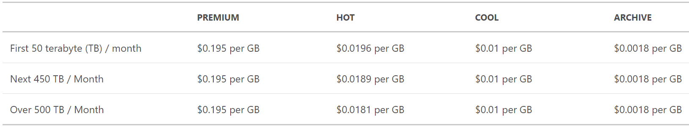
Cloud Storage
After 1 year: 221TB => 398$

Slide 146
Muscar.auto
Architecture
User Interface / Service Interface
Business Logic
Data Access
Data Store

Slide 147
Muscar.auto
Telemetry Processor Redundancy
Load Balancer
Telemetry Processor
Telemetry Processor
Telemetry Processor

Slide 148
Muscar.auto
Components
Cars
Telemetry gateway
Receives telemetry from cars
Telemetry pipeline
Queues the telemetry messages for processing
Queries the operational DB and displays real time data
Telemetry processor
Validates the messages and stores them
Telemetry Viewer
Operational DB
Archive DB
Data Warehouse
Reports and analysis
BI Application

Slide 149
Muscar.auto
Telemetry Viewer
What it does:
Allows end users to query telemetry data
Displays real time data
What it doesn’t:
- Analyzes the data

Slide 150
Muscar.auto
Application Type
Web App & Web API
Mobile App
Console
Service
Desktop App

Slide 151

Muscar.auto
Technology Stack
Back End
Front End

Slide 152
Muscar.auto
Architecture
Service Interface
Business Logic
Data Access
Data Store

Slide 153
Muscar.auto
API
Get latest errors for all cars
Get latest telemetry for specific car
Get latest errors for specific car

Slide 154
Muscar.auto
API
Functionality | Path | Return Codes
Get latest errors for all cars | GET /api/v1/telemetry/errors | 200 OK
Get latest telemetry for specific car | GET /api/v1/telemetry/{carId} | 200 OK 404 Not Found
Get latest errors for specific car | GET /api/v1/telemetry/errors/{carId} | 200 Ok 404 Not Found

Slide 155
Muscar.auto
Telemetry Viewer Redundancy
Load Balancer
Telemetry Viewer
Telemetry Viewer
Telemetry Viewer

Slide 156
Muscar.auto
Components
Cars
Telemetry gateway
Receives telemetry from cars
Telemetry pipeline
Queues the telemetry messages for processing
Queries the operational DB and displays real time data
Telemetry processor
Validates the messages and stores them
Telemetry Viewer
Operational DB
Archive DB
Data Warehouse
Reports and analysis
BI Application

Slide 157
Muscar.auto
BI Application
Business Intelligence
What it does:
Analyzes telemetry data
Displays custom reports about the data, trends, forecasts etc.
How many cars did break during the last month?
What is the total distance the cars drove?

Slide 158
Muscar.auto
Application Type
Doesn’t matter
BI Application is ALWAYS based on an existing tool

Slide 159




Muscar.auto
BI Tools

Slide 160
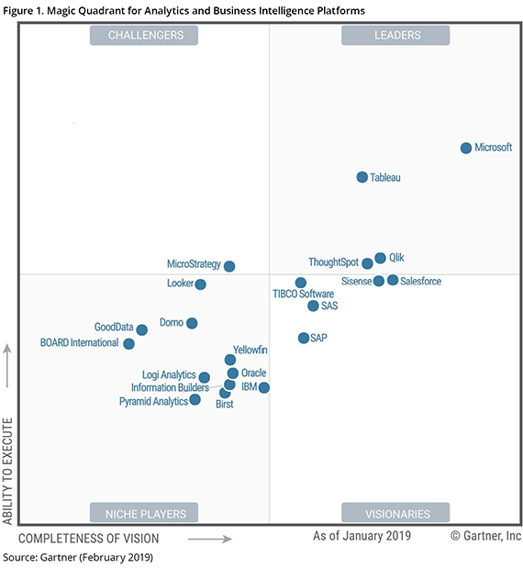
Muscar.auto
BI Tools

Slide 161
Muscar.auto
BI Tools
An important lesson:
Designing BI solution is NOT part of the architect’s job
ALWAYS use BI expert for this task

Slide 162
Muscar.auto
Logic Diagram
Cars
Telemetry gateway
Telemetry pipeline
Telemetry processor
Telemetry Viewer
Operational DB
Archive DB
Data Warehouse
BI Application

Slide 163
Muscar.auto
Technical Diagram
Cars
Telemetry gateway
NodeJS
Telemetry pipeline
Kafka
Telemetry processor
Telemetry Viewer
NodeJS
NodeJS
Operational DB
Archive DB
Data Warehouse
???
BI Application
MongoDB
Azure Storage

Slide 164
Muscar.auto
Physical Diagram
LB
Cars
Telemetry gateway
Telemetry gateway
Telemetry gateway
Product’s High Availability
Telemetry pipeline
LB
LB
Telemetry processor
Product’s High Availability
Telemetry Viewer
Telemetry processor
Telemetry Viewer
Telemetry processor
Telemetry Viewer
Operational DB
Archive DB
Data Warehouse
BI Application

Slide 165

GroceColl

Slide 166
GroceColl
Grocery collection service
Allows customers to create shopping lists that get collected and delivered by GroceColl’s employees
Available world-wide

Slide 167
GroceColl
Employees have dedicated tablets displaying the list
We need to design the collection side of the system
The customer side is already developed

Slide 168
Requirements
Functional
Non-Functional
What the system should do
What the system should deal with
Web Based
Tablets receive list to be collected
Employees can mark items as collected or unavailable
When collection is done, the list should be transferred to payment engine
Offline support is a must

Slide 169
NFR - What We Ask
“How many expected concurrent users?”
“How many lists will be processed per day?”
“What is the average size of a shopping list?”
200
10,000
500KB

Slide 170
NFR - What We Ask
“Do we need offline support?”
“What is the desired SLA?”
“How do lists arrive to the system?”
Yes!
Highest Possible
Queue

Slide 171
Data Volume
1 List = 500KB
10,000 lists / day = 5GB / day
=> ~2TB / year

Slide 172
Requirements
Functional
Non-Functional
What the system should do
What the system should deal with
Web Based
Tablets receive list to be collected
Employees can mark items as collected or unavailable
When collection is done, the list should be transferred to payment engine
Offline support is a must
200 Concurrent users
10,000 lists/day
Yearly volume: 2TB
High SLA
Offline support

Slide 173

Components
Based on requirements:
Employees have tablets
Offline support
Retrieve lists
Mark Items
Export list to payment engine
Displays list, marks items, offline support
Receives lists from the queue and stores them
Retrieves list to be handled. Updates and exports items and lists
Lists Queue
Lists Receiver
Lists Service
Lists DB
Lists Data
Data to be exported to the payment engine

Slide 174
Messaging
Based on requirements:
Employees have tablets
Offline support
Retrieve lists
Mark Items
Export list to payment engine
Displays list, marks items, offline support
Receives lists from the queue and stores them
REST
Retrieves list to be handled. Updates and exports items and lists
Lists Queue
Lists Receiver
Lists Service
Queue
Lists DB
Lists Data
Data to be exported to the payment engine

Slide 175
Components
Displays list, marks items, offline support
Receives lists from the queue and stores them
Retrieves list to be handled. Updates and exports items and lists
Lists Queue
Lists Receiver
Lists Service
Lists DB
Lists Data
Data to be exported to the payment engine

Slide 176
Lists Receiver
What it does:
Receives shopping lists to be handled from queue
Stores the lists in the datastore

Slide 177
Application Type
Web App & Web API
Mobile App
Console
Service
Desktop App

Slide 178
Technology Stack
Considerations:
Should be able to connect to queue
Not much else…

Slide 179
Technology Stack
We’re basically a Java shop, and our database of choice is MySQL.
Java is a perfect fit for this task, so we’ll go with it.

Slide 180
Technology Stack
We’re basically a Java shop, and our database of choice is MySQL.
What about database?
Our data is relational, and MySQL is a relational DB
Expected volume is 2TB/Year which is a lot
But can utilize partitioning
So…

Slide 181


Technology Stack

Slide 182
Architecture
Queue Receiver
Business Logic
Data Access
Data Store

Slide 183
Lists Receiver Redundancy
Consumer Group
Lists Receiver
Lists Receiver
Lists Receiver

Slide 184
Components
Displays list, marks items, offline support
Receives lists from the queue and stores them
Retrieves list to be handled. Updates and exports items and lists
Lists Queue
Lists Receiver
Lists Service
Lists DB
Lists Data
Data to be exported to the payment engine

Slide 185
Lists Service
What it does:
Allows employees to query lists
Marks items in list
Exports payment data

Slide 186
Application Type
Web App & Web API
Mobile App
Console
Service
Desktop App

Slide 187
Technology Stack

Slide 188
Architecture
Service Interface
Business Logic
Data Access
Data Store

Slide 189
API
Get next list to be processed (by location)
Mark item as collected / unavailable
Export list’s payment data

Slide 190
API
Functionality | Path | Return Codes
Get next list to be processed | GET /api/v1/lists/next?location=… | 200 OK 400 Bad Request
Mark item as collected / unavailable | PUT /api/v1/list/{listId}/item/{itemId} | 200 OK 404 Not Found
Export list’s payment data | POST /api/v1/list/{listId}/export | 200 Ok 404 Not Found

Slide 191
Lists Service Redundancy
Load Balancer
Lists Service
Lists Service
Lists Service

Slide 192
Components
Displays list, marks items, offline support
Receives lists from the queue and stores them
Retrieves list to be handled. Updates and exports items and lists
Lists Queue
Lists Receiver
Lists Service
Lists DB
Lists Data
Data to be exported to the payment engine

Slide 193
Front End
What it does:
Displays shopping list
Marks items as unavailable / collected
Sends list to payment system
Supports offline mode

Slide 194
Application Type
Web App & Web API
Mobile App
Console
Service
Desktop App

Slide 195
Technology Stack
Need to decide between:
Desktop, windows based (WPF)
Web based (Electron, React Native)
Supports all OS functionalities
Utilizes other apps on the machine (ie. DB)
Requires setup, Windows
Limited functionality
Cannot use other apps
Fully compatible with other form factors (phones, etc.)
No setup required
Cheaper hardware

Slide 196

Technology Stack
Need to decide between:
Web based (Electron, React Native)
Limited functionality
Cannot use other apps
Fully compatible with other forms (phones, etc.)
No setup required
Cheaper hardware

Slide 197
Front End Redundancy
Not Relevant…

Slide 198
Components
Displays list, marks items, offline support
Receives lists from the queue and stores them
Retrieves list to be handled. Updates and exports items and lists
Lists Queue
Lists Receiver
Lists Service
Lists DB
Lists Data
Data to be exported to the payment engine

Slide 199
Export Lists Data
What it does:
Used to send shopping lists’ data to payment system
Basically – a queue

Slide 200
Export Lists Data- Questions
Is there an existing queue mechanism in the company?
Develop our own or use 3rd party?
Yes

Slide 201
Components
Displays list, marks items, offline support
Receives lists from the queue and stores them
Retrieves list to be handled. Updates and exports items and lists
Lists Queue
Lists Receiver
Lists Service
Lists DB
Lists Data
Data to be exported to the payment engine

Slide 202
Components
Displays list, marks items, offline support
Receives lists from the queue and stores them
Retrieves list to be handled. Updates and exports items and lists
Lists Queue
Lists Receiver
Lists Service
Lists DB
Data Queue
Data to be exported to the payment engine

Slide 203
Logic Diagram
Lists Queue
Lists Receiver
Lists Service
Lists DB
Data Queue

Slide 204
Technical Diagram
React Native
Lists Queue
Lists Receiver
Lists Service
Java
Java
Lists DB
Data Queue
Whatever is used by the company
MySQL

Slide 205
Physical Diagram
N/A
Consumer Group
LB
Lists Queue
Lists Receiver
Lists Service
Product’s High Availability
Lists Receiver
Lists Service
Lists Receiver
Lists Service
Lists DB
Data Queue

Slide 206

PayRawl

Slide 207
PayRawl
Payment processing system
Receives files from various sources
Validates and processes the files
Sends instruction files to banks
Fully automatic, no UI

Slide 208
Requirements
Functional
Non-Functional
What the system should do
What the system should deal with
Receive file to be processed
Validate and process the file
Work with various file formats
Perform various calculations on the file
Create bank payment file
Put the payment file in a designated folder
Keep log of all the activity for 7 years

Slide 209
NFR - What We Ask
“How many files per day?”
“How long should the process take?”
“What is the average size of a file?”
“Can we tolerate data loss?”
500
1 min
1MB
Absolutely Not!

Slide 210
Data Volume - Files
1 File = 1MB
500 files / day = 500MB / day
=> ~182GB / year
=> ~1.3TB / 7 years

Slide 211
Data Volume - Log
Assuming each processing generates 500KB log data
500 files / day = 250MB log data / day
=> ~91GB log data / year
=> ~638GB log data / 7 years

Slide 212
Requirements
Functional
Non-Functional
What the system should do
What the system should deal with
Receive file to be processed
Validate and process the file
Work with various file formats
Performs various calculations on the file
Create bank payment file
Put the payment file in a designated folder
Keep log of all the activity for 7 years
500 files / day
No data loss
1 min processing time
Activity log for 7 years
~2TB / 7 years

Slide 213

Components
Receive file to be processed
Validate and process the file
Work with various file formats
Perform various calculations on the file
Create bank payment file
Put the payment file in a designated folder
Keep log of all the activity for 7 years
Logs
Exports file to bank folder
Convert files to unified format
Gets files from folders
Performs calculations
File Exporter
File Formatter
File Handler
Files Queue
File Formatter
Formatted Files Queue
File Calculation
Calculated Files Queue
File Formatter

Slide 214
The Queue
Receive file to be processed
Validate and process the file
Work with various file formats
Perform various calculations on the file
Create bank payment file
Put the payment file in a designated folder
Keep log of all the activity for 7 years
Logs
Exports file to bank folder
Convert files to unified format
Gets files from folders
Performs calculations
File Exporter
File Formatter
File Handler
Files Queue
File Formatter
Formatted Files Queue
File Calculation
Calculated Files Queue
File Formatter

Slide 215
The Queue
- Passes payloads from logic unit to another
- Balances load
Persists messages (Durability!)

Slide 216
The Queue
Asynchronous
Which is good since we don’t have UI

Slide 217

The Queue
Which queue?
General purpose
Easy to setup
Not suitable for streaming scenarios
Great for streaming scenarios and high-load systems
Complex to setup

Slide 218
The Queue
Which queue?
General purpose
Easy to setup
Not suitable for streaming scenarios

Slide 219
The Queue
Queue is usually represented like this:
So…

Slide 220
Components
Receive file to be processed
Validate and process the file
Work with various file formats
Performs various calculations on the file
Create bank payment file
Put the payment file in a designated folder
Keep log of all the activity for 7 years
Logs
Exports file to bank folder
Convert files to unified format
Gets files from folders
Performs calculations
File Exporter
File Formatter
File Handler
Files Queue
File Formatter
Formatted Files Queue
File Calculation
Calculated Files Queue
File Formatter

Slide 221
Components
Receive file to be processed
Validate and process the file
Work with various file formats
Performs various calculations on the file
Create bank payment file
Put the payment file in a designated folder
Keep log of all the activity for 7 years
Logs
Exports file to bank folder
Convert files to unified format
Gets files from folders
Performs calculations
File Exporter
File Formatter
File Handler
File Formatter
File Calculation
File Formatter

Slide 222
Components
Logs
Exports file to bank folder
Convert files to unified format
Gets files from folders
Performs calculations
File Exporter
File Formatter
File Handler
File Formatter
File Calculation
File Formatter

Slide 223
File Handler
What it does:
Pulls payment files from folders
Put the files in the queue

Slide 224
Application Type
Web App & Web API
Mobile App
Console
Service
Desktop App

Slide 225
Technology Stack
Considerations:
Should be able to pull files from folders
Should be able to connect to queue
Not much else…

Slide 226

Technology Stack
This is a brand new company, we don’t have existing knowledge. What would you recommend?

Slide 227
Technology Stack
What we’re looking for:
Performance
Community
Cross Platform
Easy to learn and use
Evolving
Great threading support

Slide 228

Technology Stack
Our candidates:

Slide 229
Technology Stack
Node is mainly for web apps, our component is a service, so…

Slide 230
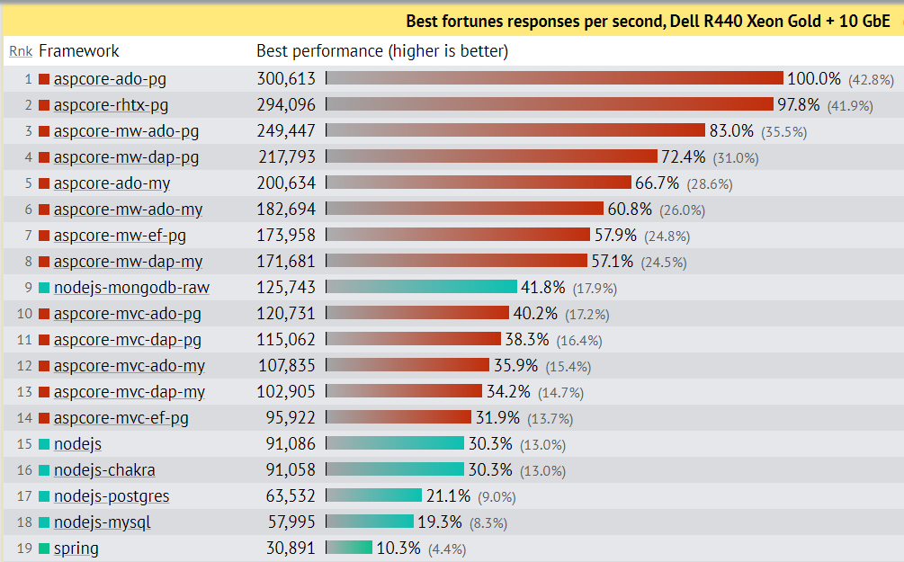
Technology Stack
Performance:
Source: https://www.techempower.com/benchmarks/#section=data-r18&hw=ph&test=fortune&l=zik0ot-f&p=zik0zj-zijocf-zijocf-4atpfj

Slide 231
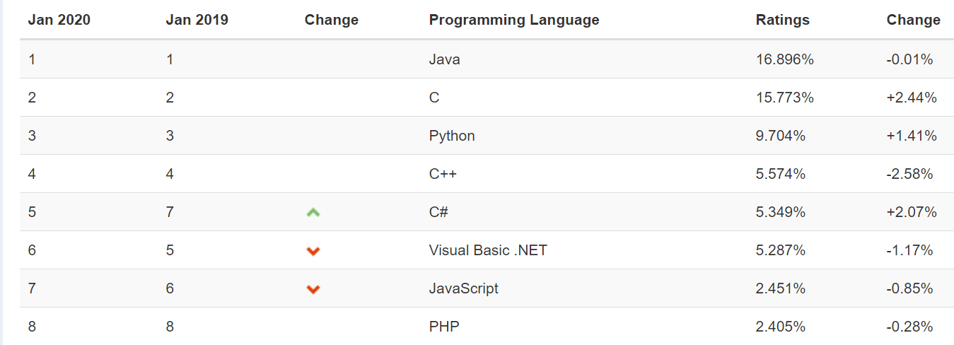
Technology Stack
Community:
Source: https://www.tiobe.com/tiobe-index/

Slide 232
Technology Stack
Cross Platform:

Slide 233
Technology Stack
Ease to learn and use:

Slide 234
Technology Stack
Evolving?
Next versions planned until 2021
Roadmap announced until 2023

Slide 235
Technology Stack
Threading support:

Slide 236
Technology Stack - Decision

Slide 237
Architecture
Traditional:
User Interface / Service Interface
Business Logic
Data Access
Data Store

Slide 238
Architecture
File Watcher
Topic is selected by file location

Slide 239
Redundancy
File Handler
Is Alive
File Handler

Slide 240
Components
Logs
Exports file to bank folder
Convert files to unified format
Gets files from folders
Performs calculations
File Exporter
File Formatter
File Handler
File Formatter
File Calculation
File Formatter

Slide 241
File Formatter
What it does:
Receives files from its specific topic
Validates and formats the file to unified format
Puts the new file in a queue
New formatters will be developed for new file formats

Slide 242
Application Type
Web App & Web API
Mobile App
Console
Service
Desktop App

Slide 243
Technology Stack

Slide 244
Architecture
Queue Receiver
Business Logic

Slide 245
File Formatter Redundancy
Consumer Group
File Formatter
File Formatter
File Formatter

Slide 246
Components
Logs
Exports file to bank folder
Convert files to unified format
Gets files from folders
Performs calculations
File Exporter
File Formatter
File Handler
File Formatter
File Calculation
File Formatter

Slide 247
File Calculation
What it does:
Receives files from the queue
Performs some calculations on the data
Puts the new file in a queue

Slide 248
File Calculation
Quite similar to the file formatter, so:
Tech Stack: .NET Core
2 layers architecture
Redundancy using Consumer Group

Slide 249
Components
Logs
Exports file to bank folder
Convert files to unified format
Gets files from folders
Performs calculations
File Exporter
File Formatter
File Handler
File Formatter
File Calculation
File Formatter

Slide 250
File Exporter
What it does:
Receives files from the queue
Puts the file in the bank’s folder

Slide 251
File Exporter
Quite similar to the file calculation service, so:
Tech Stack: .NET Core
2 layers architecture
Redundancy using Consumer Group

Slide 252
Components
Logs
Exports file to bank folder
Convert files to unified format
Gets files from folders
Performs calculations
File Exporter
File Formatter
File Handler
File Formatter
File Calculation
File Formatter

Slide 253
Requirements
Functional
Non-Functional
What the system should do
What the system should deal with
Receive file to be processed
Validate and process the file
Work with various file formats
Performs various calculations on the file
Create bank payment file
Put the payment file in a designated folder
Keep log of all the activity for 7 years
500 files / day
No data loss
1 min processing time
Activity log for 7 years
~2TB / 7 years

Slide 254
Logging
What we need:
Write a lot of log records
Allow easy visualizations and analytics
Preferably – based on existing platform

Slide 255



Logging
Most popular:

Slide 256
Logging
The Elastic Stack has 4 tools:
Elastic Search: Search and analytics engine
Kibana: Visualization engine
Logstash: Data collection pipeline
Beats: Lightweight log shippers

Slide 257
Logging
Or:
Elastic Search stores your log
Kibana displays the logs
Logstash and Beats bring your logs to Elastic

Slide 258
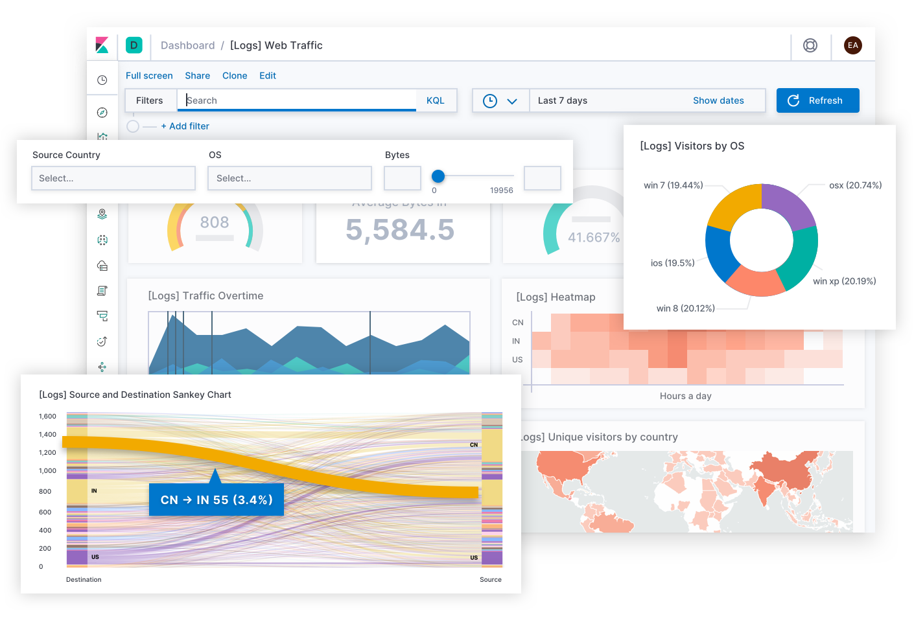
Logging

Slide 259
Logging
How do we ship logs from .NET Core to Elastic?

Slide 260
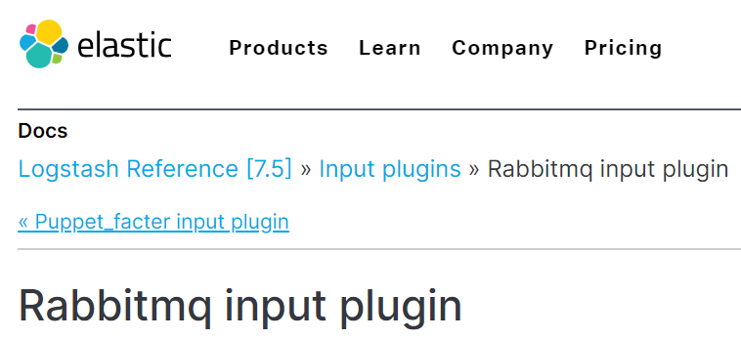
Logging
How do we ship logs from RabbitMQ to Elastic?

Slide 261
Components
Kibana
Elastic
logstash
Serilog
logstash
Serilog
logstash
Serilog
File Exporter
File Formatter
Serilog
File Handler
File Formatter
File Calculation
File Formatter

Slide 262
Logic Diagram
Logs
File Exporter
File Formatter
File Handler
File Formatter
File Calculation
File Formatter

Slide 263
Technical Diagram
Logs
Elastic Stack
.NET Core
File Exporter
File Formatter
.NET Core
File Handler
File Formatter
File Calculation
.NET Core
RabbitMQ
RabbitMQ
.NET Core
RabbitMQ
File Formatter

Slide 264
Physical Diagram
Logs
Consumer Group
Consumer Group
File Exporter
File Formatter
File Exporter
Is Alive
File Handler
File Formatter
File Calculation
File Handler
File Calculation
File Formatter
Consumer Group

